Slide 1
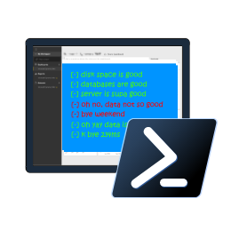
Chrissy LeMaire @cl netnerds.com
Cláudio Silva @ClaudioESSilva claudioessilva.eu
Rob Sewell @sqldbawithbeard sqldbawithAbeard.com
Reliable, Repeatable, Configurable & Automated Validation with
PowerShell dbachecks

Slide 2

Check Lists
Photo by Glenn Carstens-Peters on Unsplash

Slide 3
What is Pester?
Test Runner for PowerShell
A Unit Testing Framework
An Infrastructure Testing Framework
https://github.com/pester
Notes:
https://www.youtube.com/watch?v=lNCR5yLSwi0 -- Test your Powershell with Pester and PSScriptAnalyzer
“Untested Code is Broken Code”
Infrastructure Testing with Pester - https://www.youtube.com/watch?v=zSEK74_fsLw
Pester is a unit-testing framework for PowerShell, and perhaps the first open-source software product that ships with Windows itself!
Author Adam Bertram will walk you through the Pester philosophy, syntax, and numerous real-world examples in this "Agile-published" book.
The Pester Book
https://leanpub.com/creatinghtmlreportsinwindowspowershell
https://leanpub.com/powershell-scripting-toolmaking
https://leanpub.com/pesterbook

Slide 4
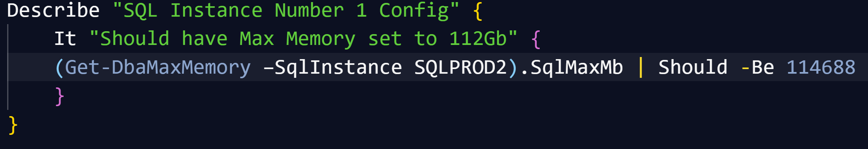
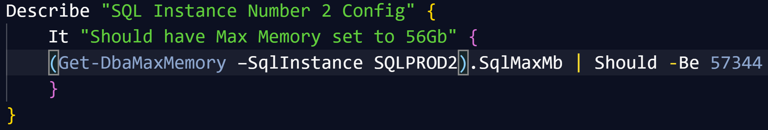
Pester
Writing Pester Tests for one SQL instance is easy
Writing slightly different Pester Tests for slightly different instances is copy and paste
It is possible to parameterize Pester tests (but not so easy to say!)

Slide 5

Challenges & Goals

Slide 6
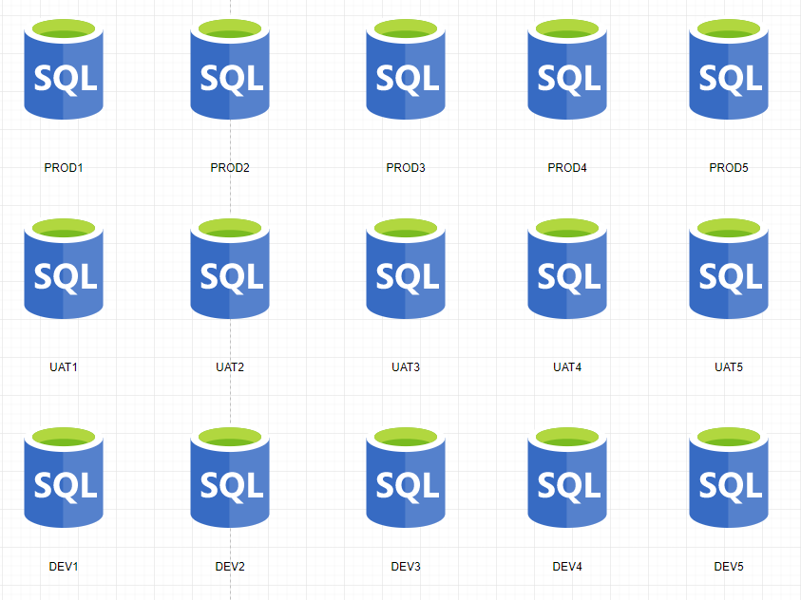
Main Challenge - Configuration
We wanted to be able to check a SQL environment like Production, UAT, DEV – horizontal
We wanted to be able to check all the SQL Environments for a whole application – vertical
We wanted to be able to check the SQL estate for a solution or system – block

Slide 7
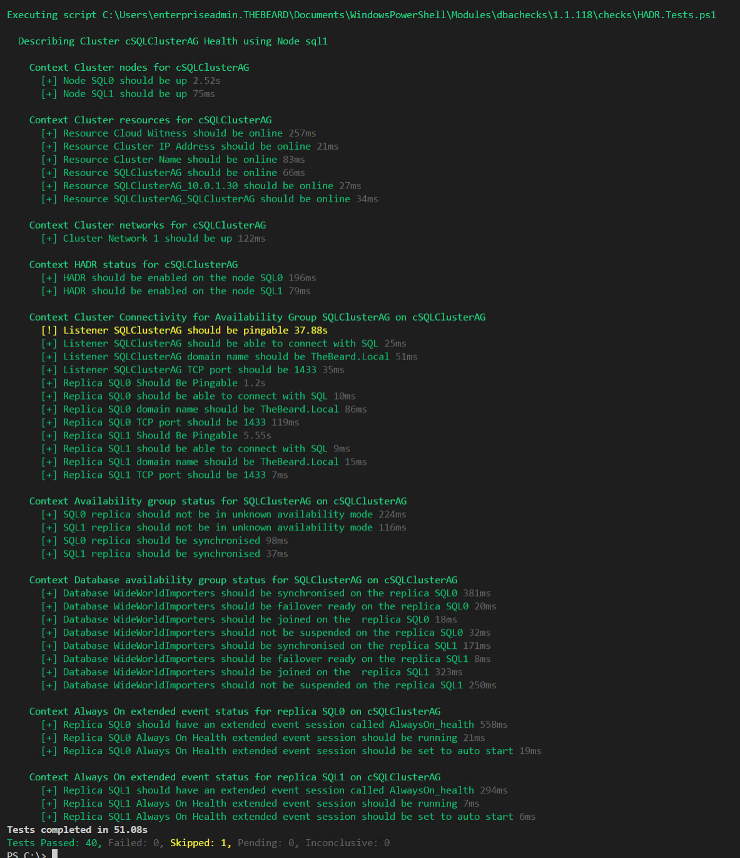
Challenge - Output
DBAs may need output instantly

Slide 8
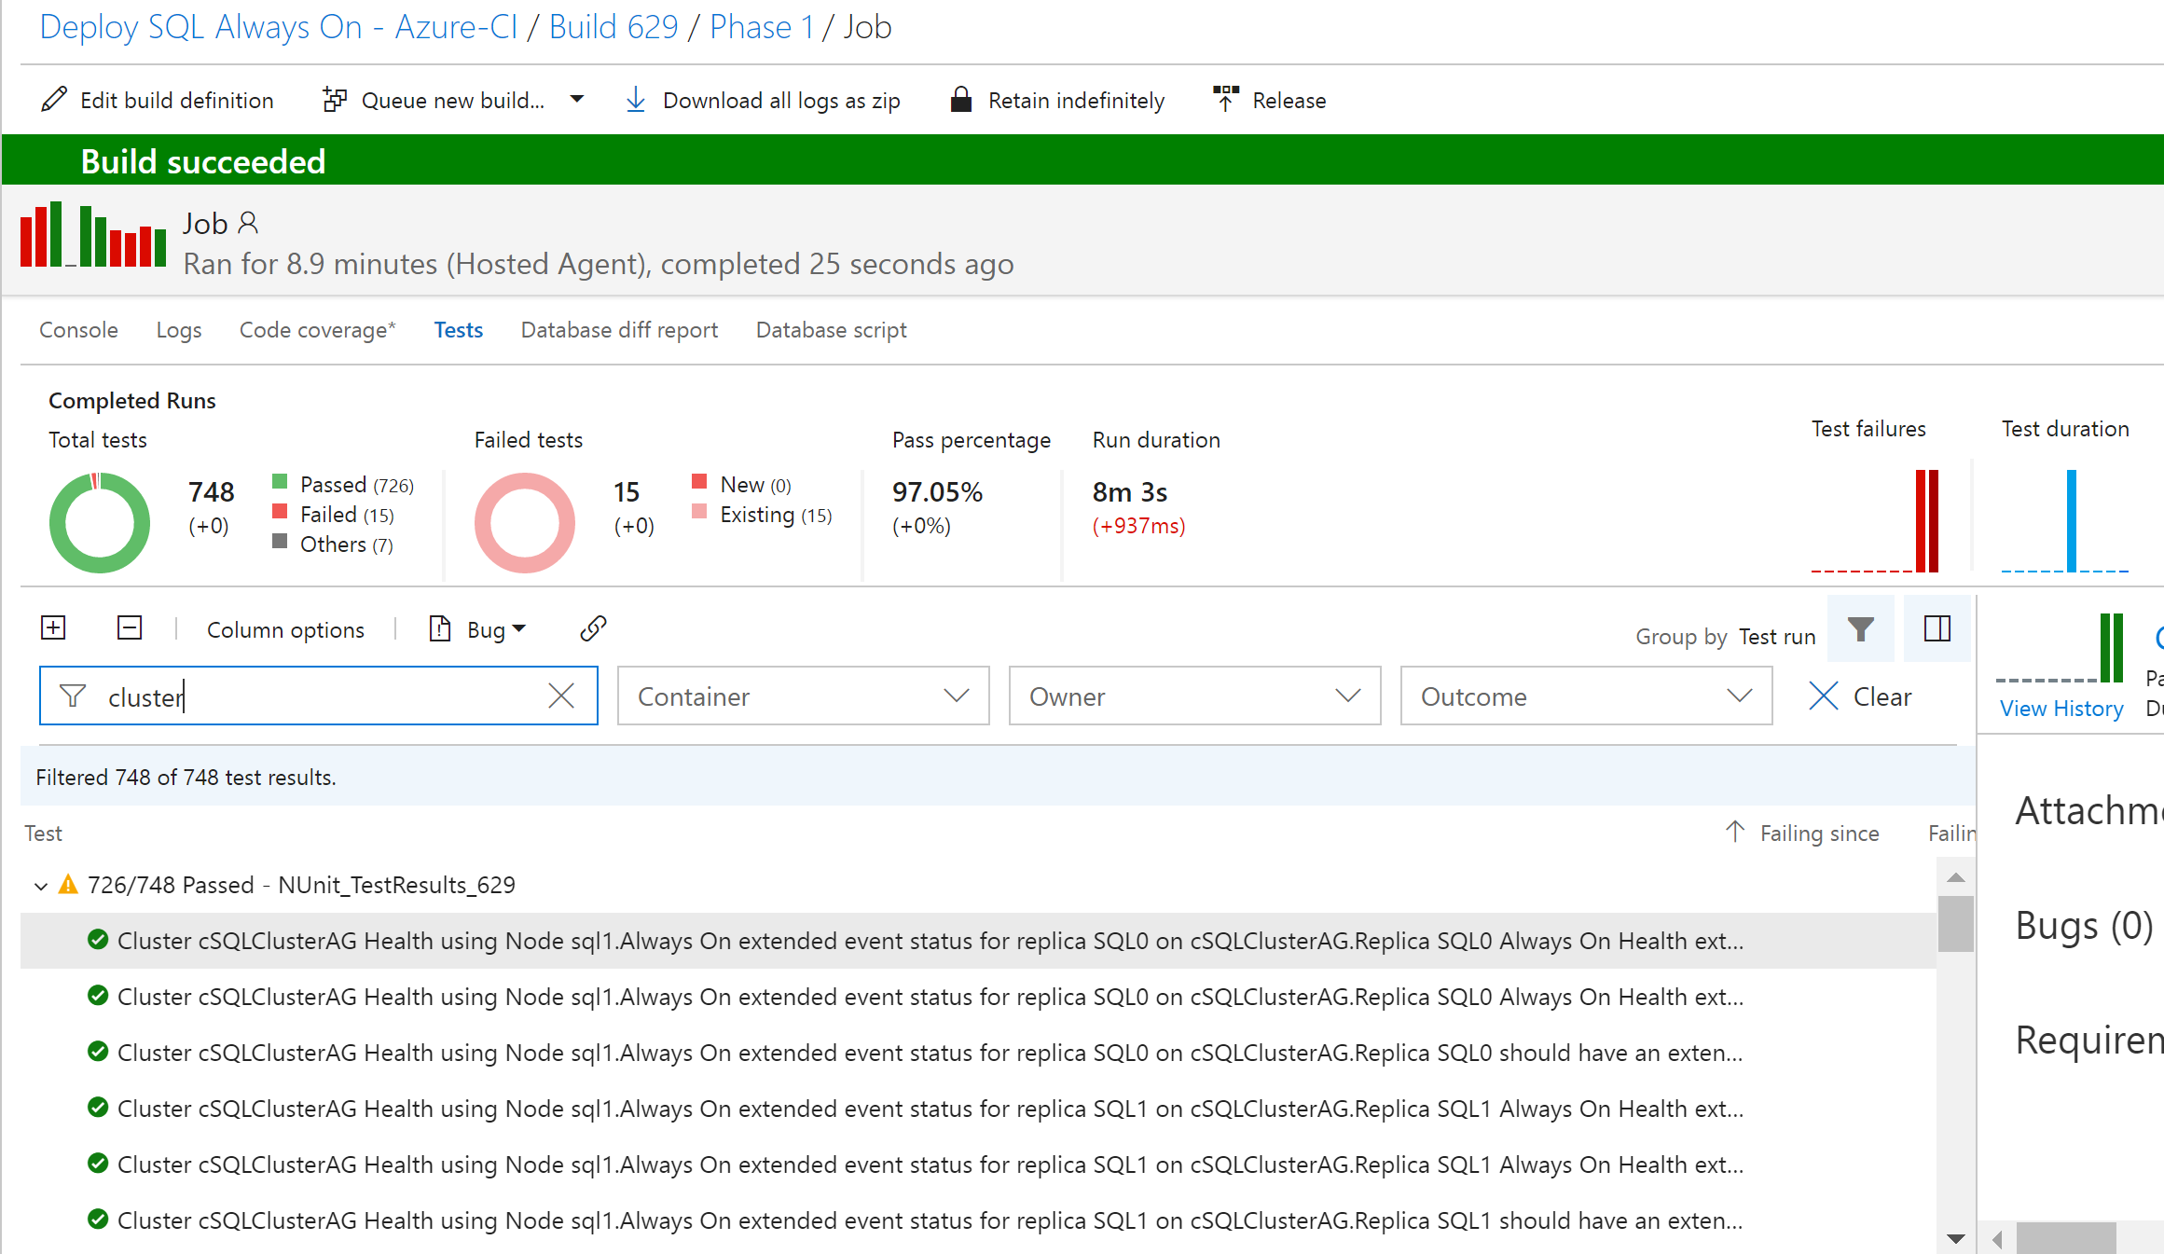
Challenge - Output
DBAs may want to automate and integrate with other solutions (DevOps, Daily Checks, Incident Response, Maintenance Windows)

Slide 9
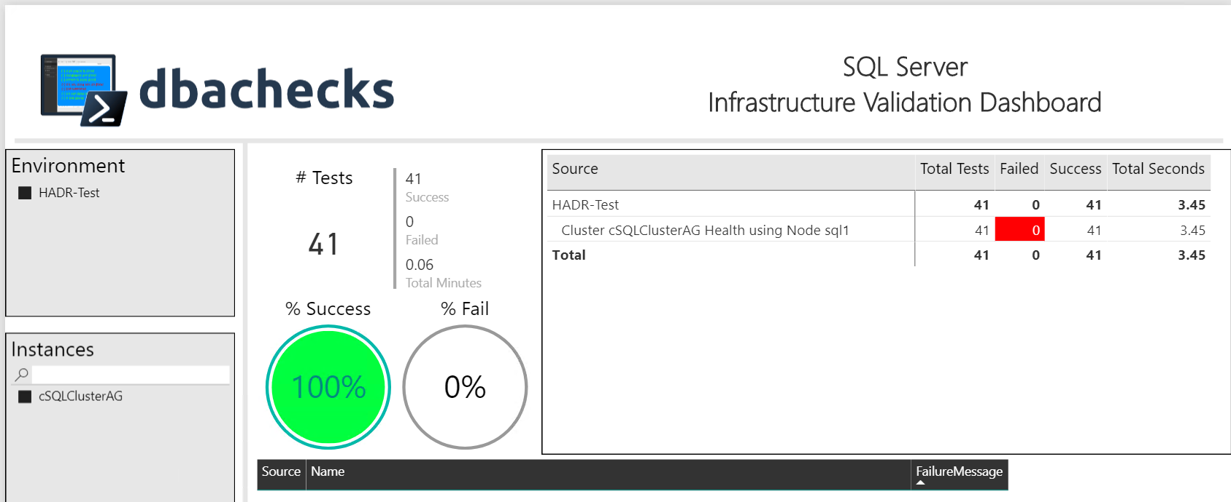
Challenge - Output
Management want output they understand
– (and with pretty interactive pictures !)

Slide 10
Our Goal
Create redistributable, easily configurable Pester tests using industry leaders checklists
Enable output to suit the requirements of different types of end users human and machine
Capability to provide response/resolution ?

Slide 11
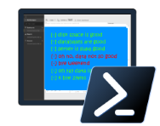
dbachecks
dbachecks is a framework created by and for SQL Server pros who need to validate their environments.
This open source module allows us to crowdsource our checklists using Pester tests.
Notes:
Basically, we all share similar checklists and mostly just the server names and RPO/RTO/etc change.

Slide 12
System Requirements
Minimum
Recommended
Client
PowerShell v4
Modules
dbatools
Pester
PSFramework
Client
PowerShell v5.1
Server
Everything dbatools supports
From SQL2000 to SQL vNext

Slide 13
Install is easy
PowerShell Gallery
Install-Module dbachecks
Install-Module dbachecks –Scope CurrentUser
* Automatically installs required modules

Slide 14
Need an offline install?
Save-Module dbachecks, dbatools, Pester, PSFramework

Slide 15
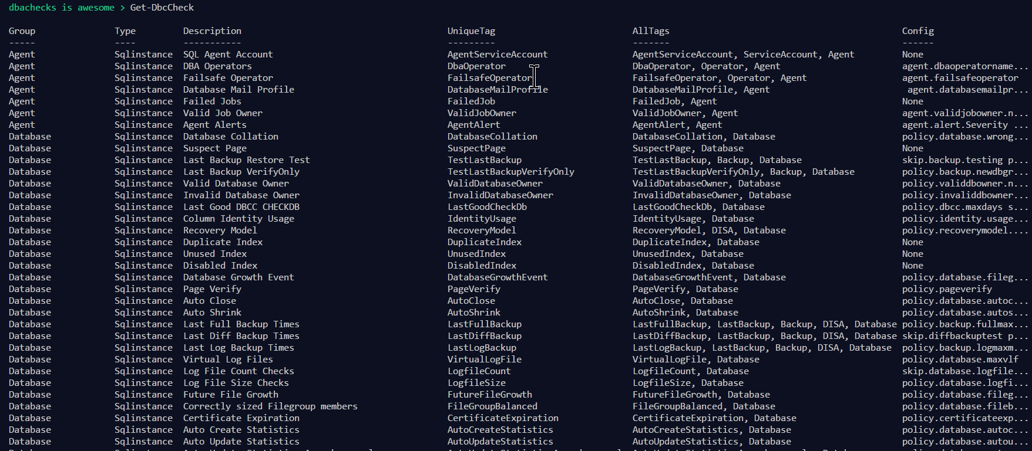
Get-DbcCheck - What Checks Are Available?

Slide 16
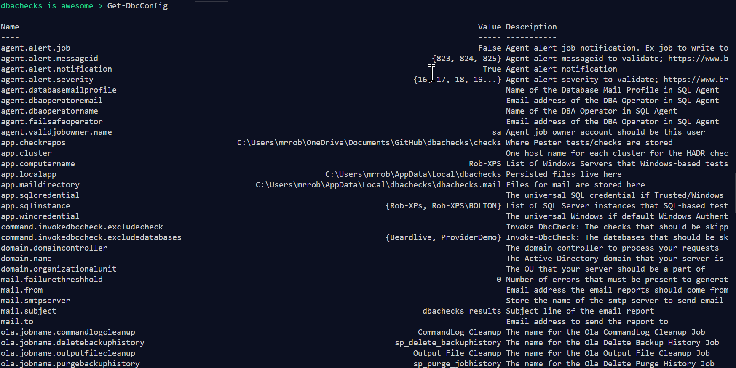
Get-DbcConfig - What Configs Are Available?

Slide 17
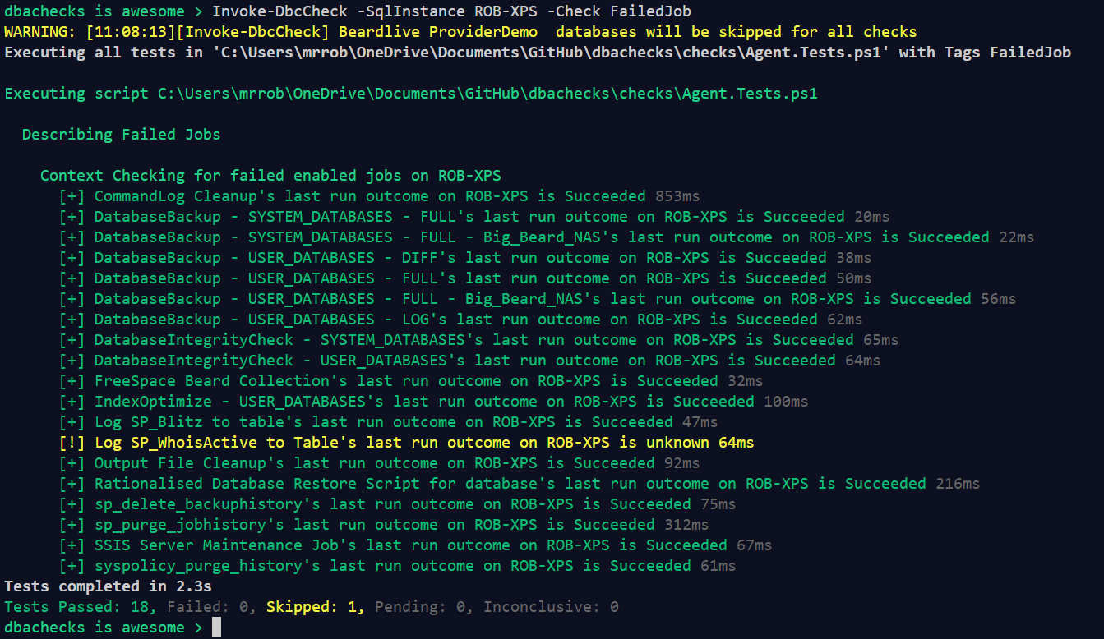
Invoke-DbcCheck – Run A Check

Slide 18
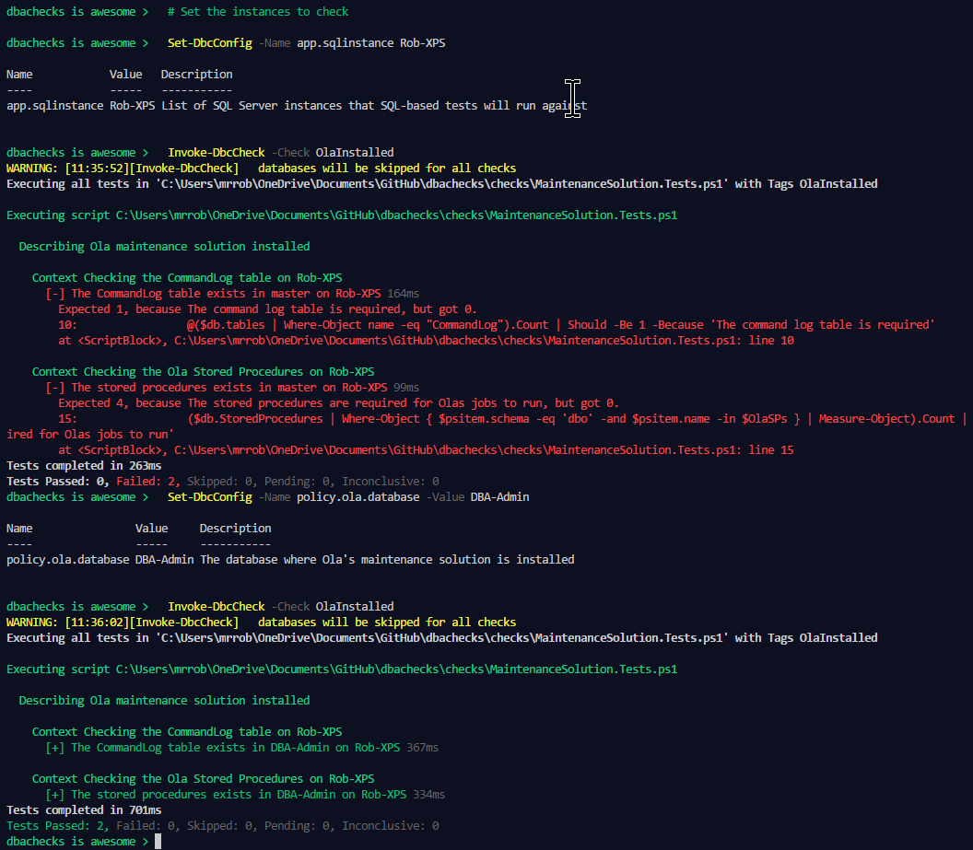
Set-DbcConfig – Config a Check
> # Set the instances to check
> Set-DbcConfig -Name app.sqlinstance Rob-XPS
> Invoke-DbcCheck -Check OlaInstalled
> Set-DbcConfig -Name policy.ola.database -Value DBA-Admin
> Invoke-DbcCheck -Check OlaInstalled

Slide 19
Export-DbcConfig/Import-DbcConfig
Export-DbcConfig –Path C:\Users\Beard\git\PesterConfigs\Application1_PROD.json
Export-DbcConfig -Path C:\Users\Hair\git\PesterConfigs\Client1_System2_Quick.json
Import-DbcConfig -Path Git:\PesterConfigs\Application1_PROD.json
Invoke-DbcCheck
Import-DbcConfig -Path Git:\PesterConfigs\Client1_System2_Quick.json
Invoke-DbcCheck

Slide 20
Start-DbcPowerBi
Import-DbcConfig –path Git:\PesterConfigs\App1_Dev.json
Invoke-DbcCheck -Show Summary -PassThru | Update-DbcPowerBiDataSource –Environment Development
Import-DbcConfig –path Git:\PesterConfigs\App1_Test.json
Invoke-DbcCheck -Show Summary -PassThru | Update-DbcPowerBiDataSource –Environment Test
Import-DbcConfig –path Git:\PesterConfigs\App1_PROD.json
Invoke-DbcCheck -Show Summary -PassThru | Update-DbcPowerBiDataSource –Environment Production
Start-DbcPowerbi

Slide 21
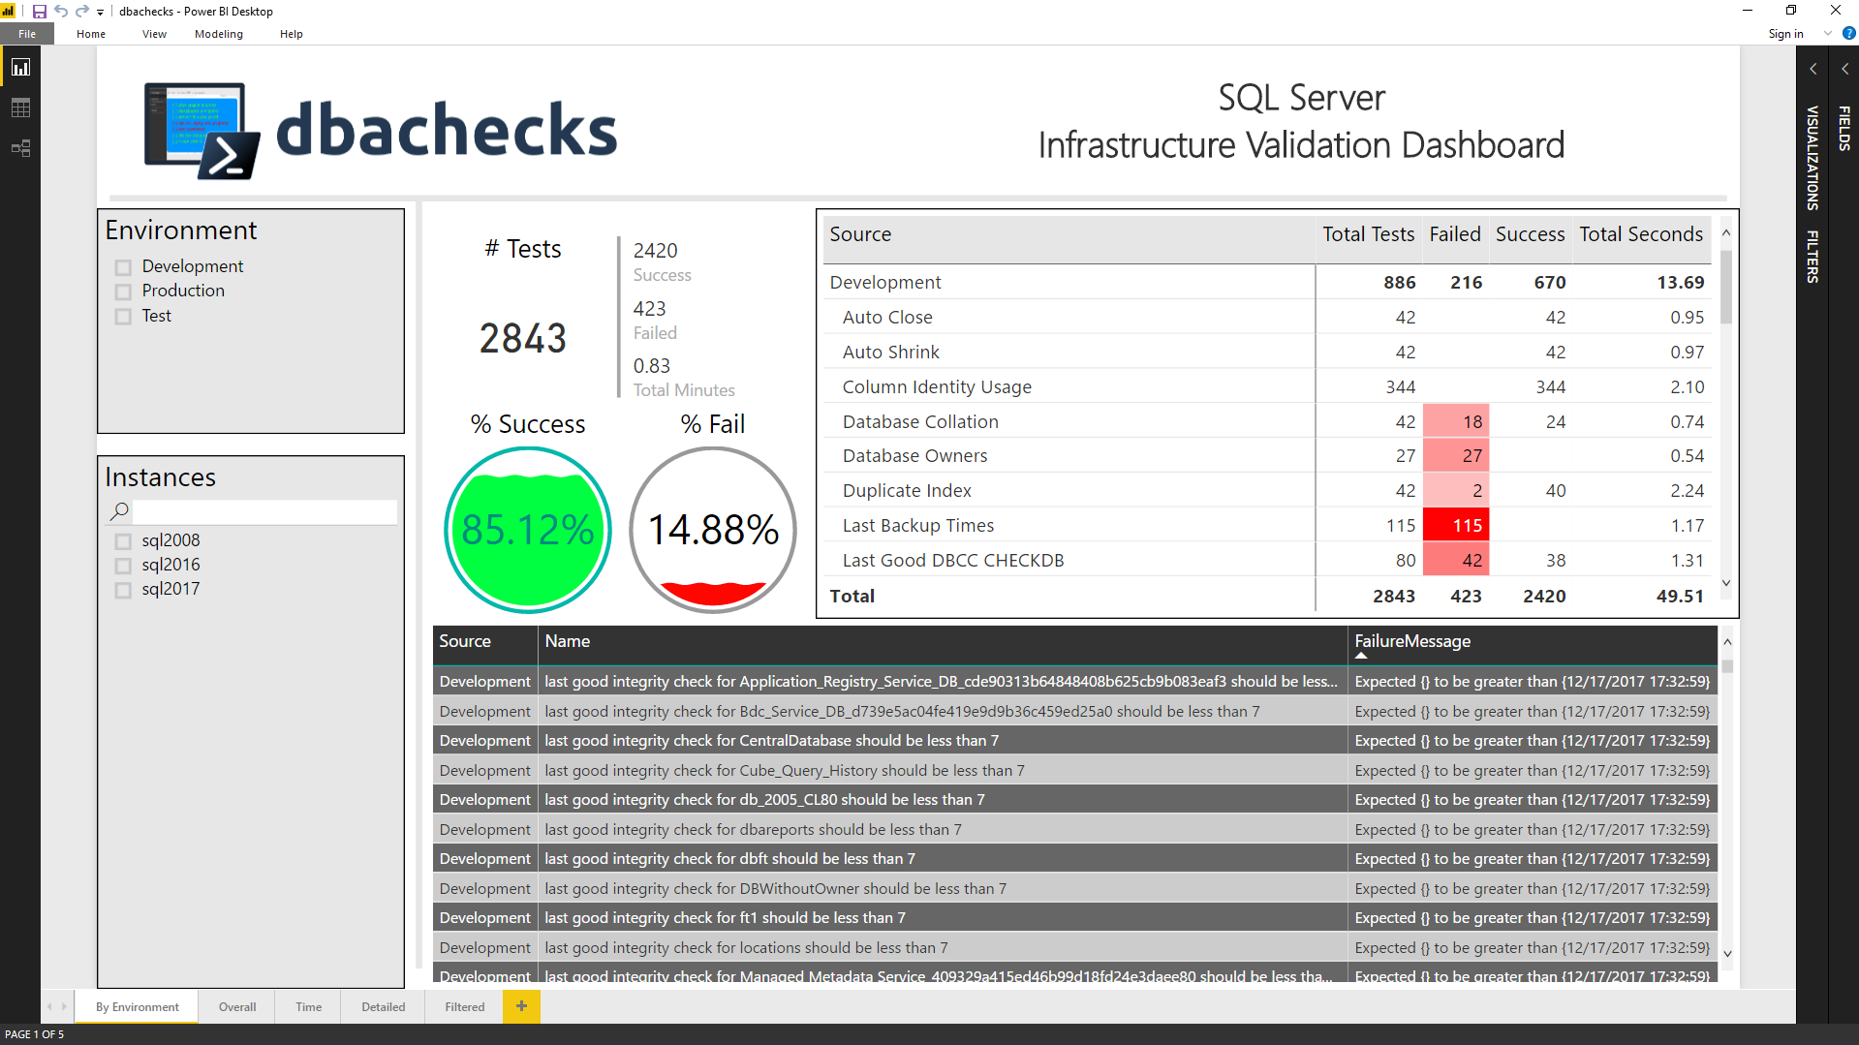
Start-DbcPowerBi

Slide 22
MUST BE TIME FOR A DEMO

Slide 23
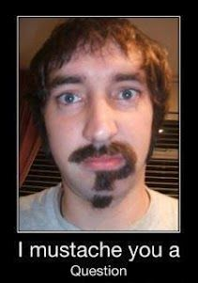
Questions?
?
?
?
?
?
?
?
?
?
?
?
?
?
?
?
?

